Slide 1
Welcome to my Presentation

Slide 2
Presented To:
Kazi Hassan Shakib
Lecturer
Dept. of CSE
City University
Presented By:
Md Pias Hossain
Id:163432563
43 Batch

Slide 3
Project Name
Online Tutoring Services
Now a days everything is on online. Online platform most used platform. Every people dependent online in single life. Recent online tutoring services is one of the famous services.

Slide 4
Background Study
Bangladesh is one of the most populated country. There have many cities. Dhaka is one of the most populated city and it is the center of national government. Manually when student need teacher guardian and student searching street wall, leaflet that’s killed our valuable time and energy. Its a big problem. My system will be solution. Its helps to find teacher easily on web.

Slide 5
Related Works
www.bdtutors.com
www.bdtutor24.com
www.caretutors.com
www.tutor.com
www.hometutorbd.com
www.dhakatutors.com
www.deshtutor.com

Slide 6
Features List
Easy to use
Totally Free
No need to go to any places
S2T and T2S
Sign Up
Login
Student/Guardian panel
Teacher panel
Comment section

Slide 7
Gantt Chart

Slide 8
Software Requirement
Editor: Notepad++
Language: HTML, CSS, PHP
Framework: WordPress
Database: MySQL

Slide 9
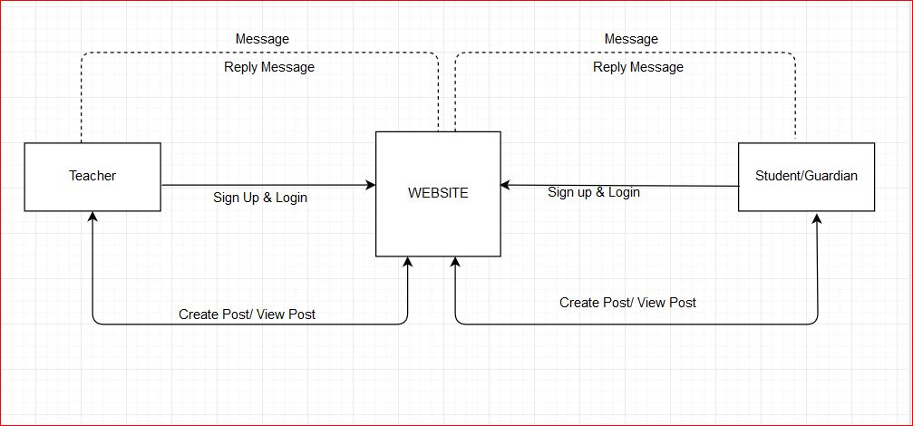
Document Flow Diagram

Slide 10
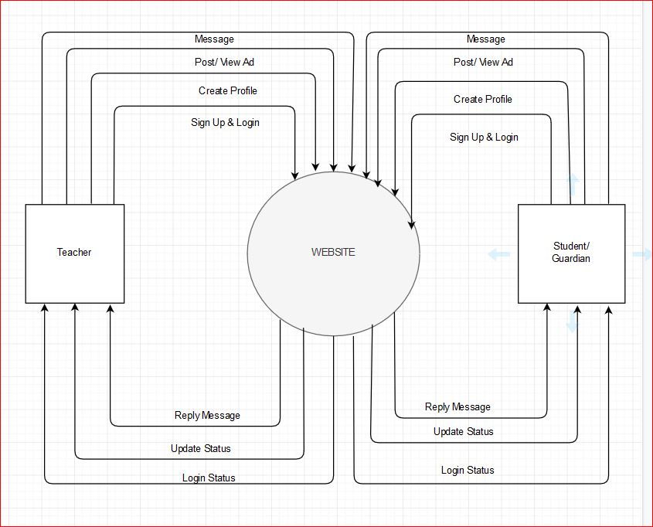
Data Flow Diagram

Slide 11
Conclusion
Every man always wants to find the way to make their life easier and more comfortable. Every day we depend on many web applications for our daily work. So, i have decided to create a website for saving our valuable time for finding new teacher and student. This website providing them chance to make an ad more easily and posting them for each other and also interact with the more easily.

Slide 12
Thank You

